Slide 1

HOUSING: PRICE PREDICTION
Submitted by:
Tanuja Patil

Slide 2
Objective Of the project
Houses are very basic need of any perosn
And that’s why market is one of the markets which is one of the major contributors in the world’s economy. It is a very large market and there are various companies working in the domain.
Main objective of this project is to predict prices of house and also predict which variables are very much important to predict price of houses.

Slide 3
To build the model we have to do following task:
First load the data set
Check shape of data set
Check data types
Check missing values and later that values should be treated properly.
Checking correlation between variables
Checking outliers and should be removed
Checking skewness
According to rolem we have to use algorithms
Encoding
PCA
Standardization
Train_test_split
Fit data
Predict data

Slide 4
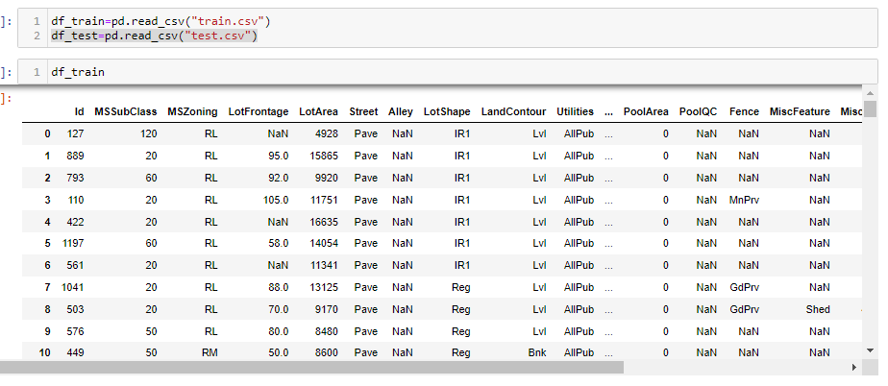
FISRT LOAD DATA SET

Slide 5
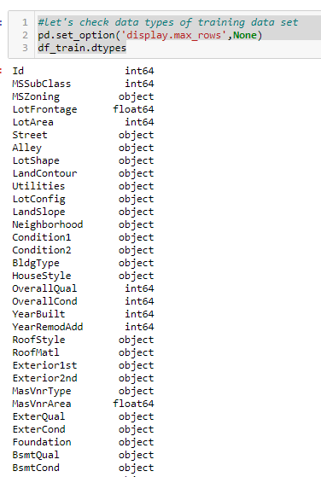
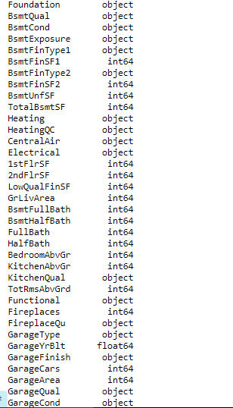
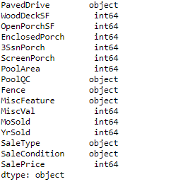
Checking dtypes

Slide 6
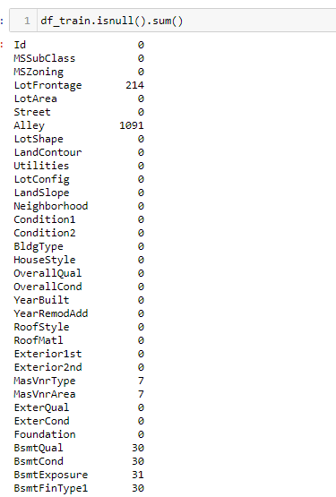
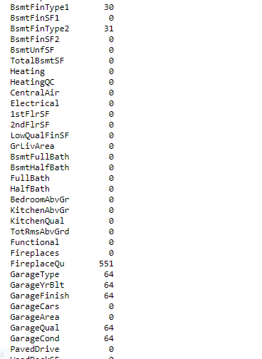
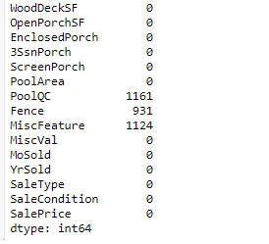
Checking missing values: Data set have many missing values so we have treat that values.

Slide 7
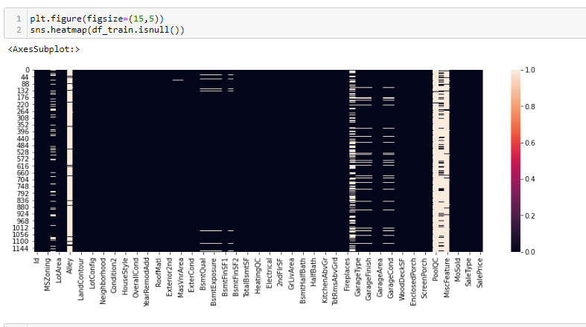
Below heatmap also shows that there are missing values.

Slide 8
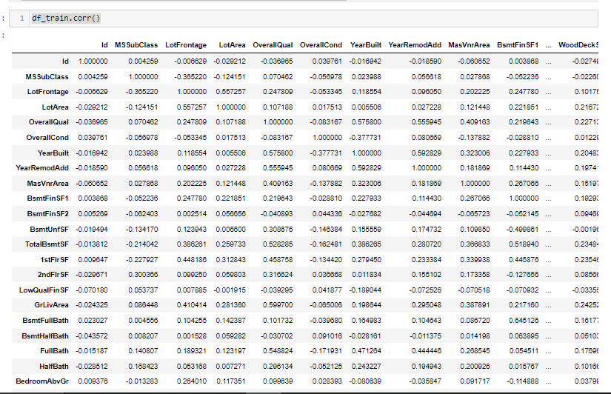
Checking correlation between variavles

Slide 9
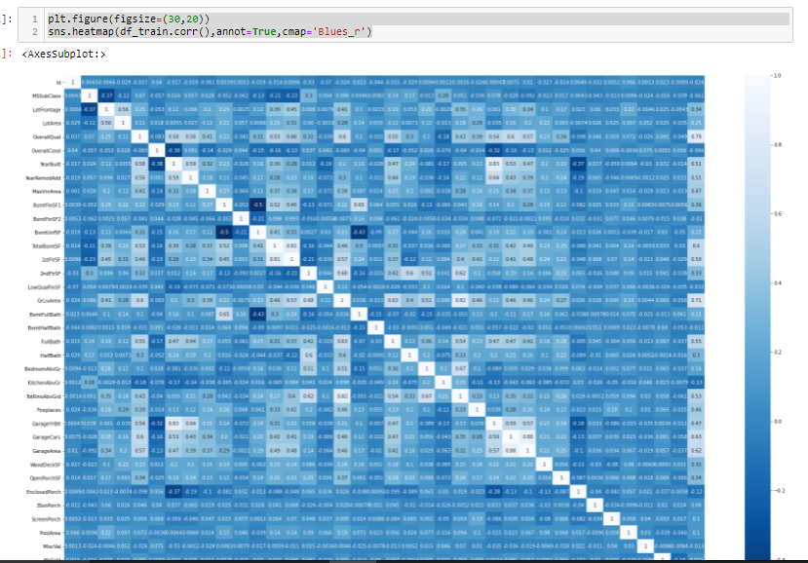
Heatmap showing correlation:

Slide 10
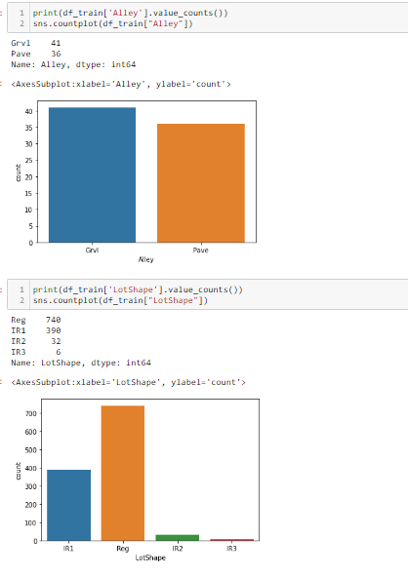
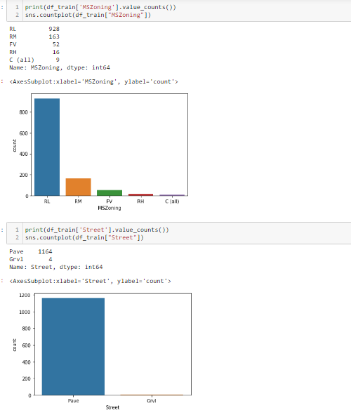
Countplot:

Slide 11
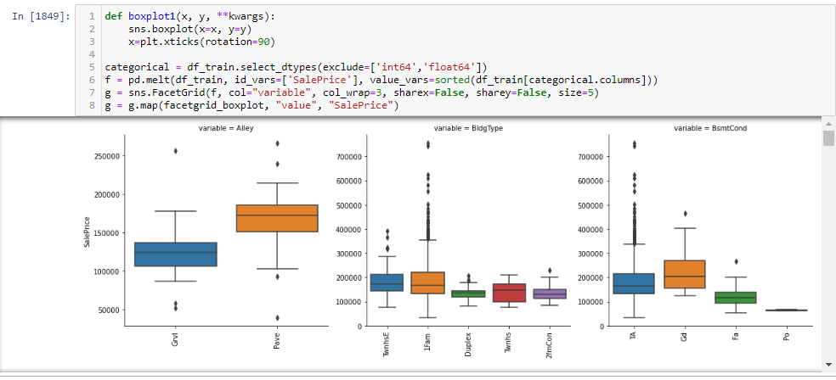
Boxplot

Slide 12
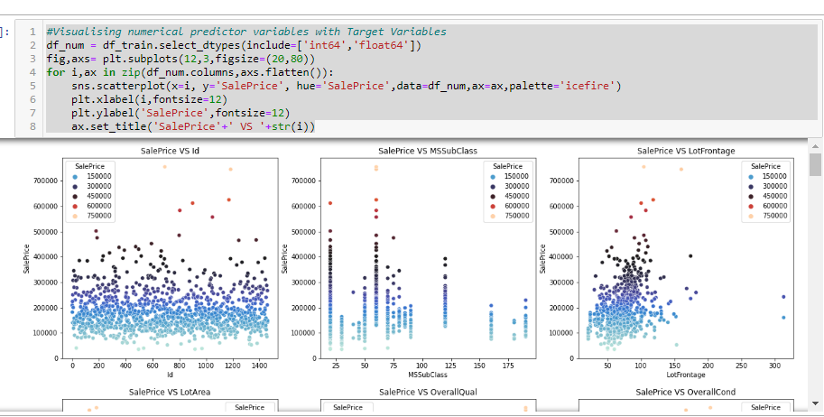
Scatterplot

Slide 13
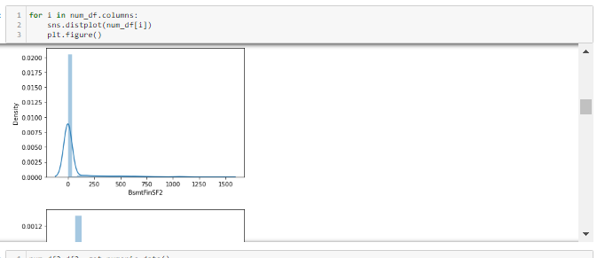
Distplot

Slide 14


Dropping columns:

Slide 15
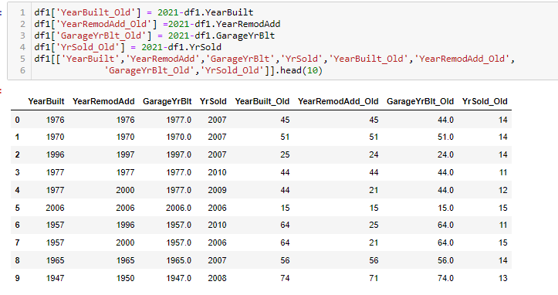
New variales:

Slide 16
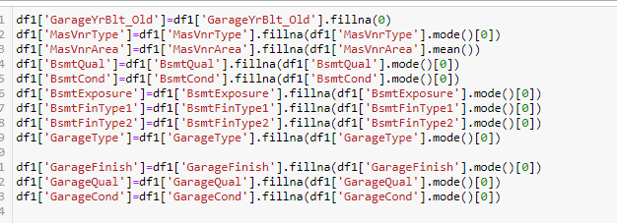
Filling missing values

Slide 17
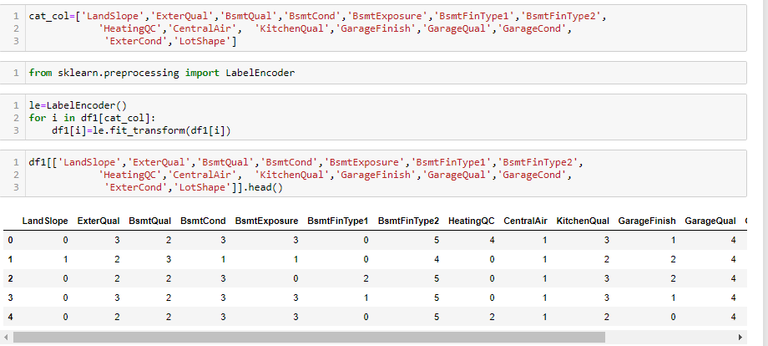
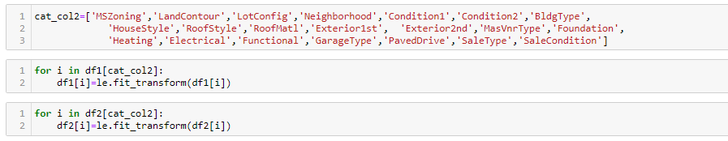
Encoding

Slide 18
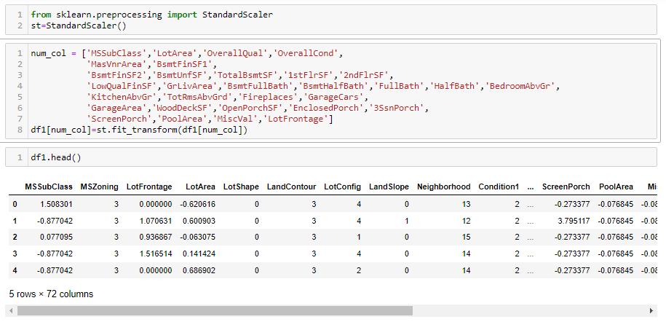
Standard scaler

Slide 19

Separate data :separating target variale from input variables

Slide 20
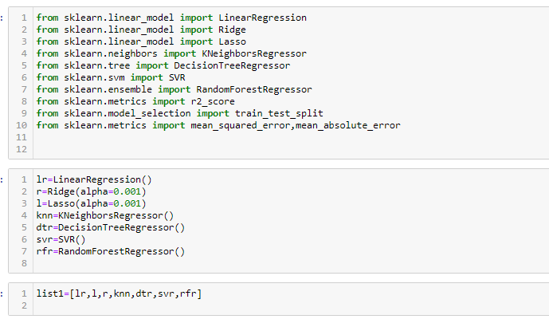
Algorithms:As this is regression type problem, we have use regression algorithms.

Slide 21
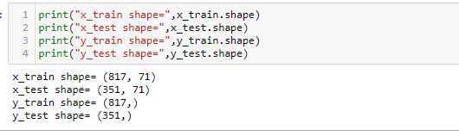
Splitting data for training and testing

Slide 22
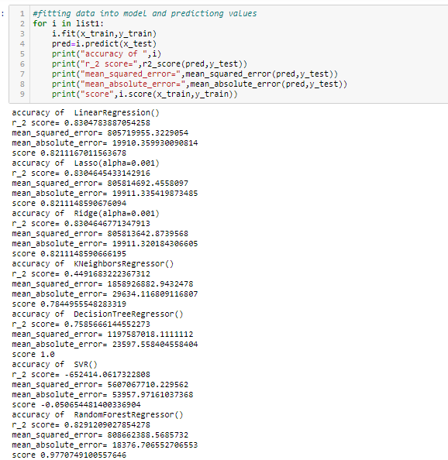
Fit data into model and predict values

Slide 23
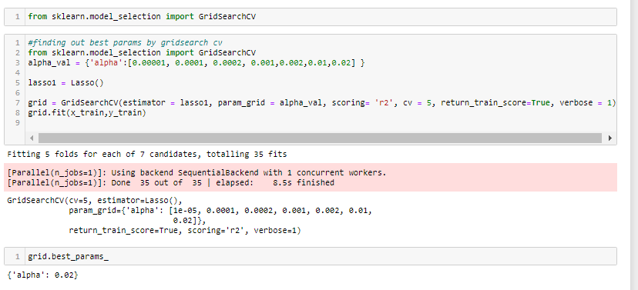
Hyperparameter tunning

Slide 24
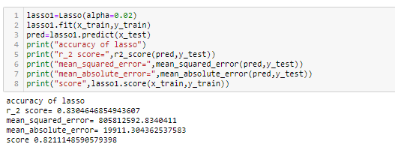

Slide 25
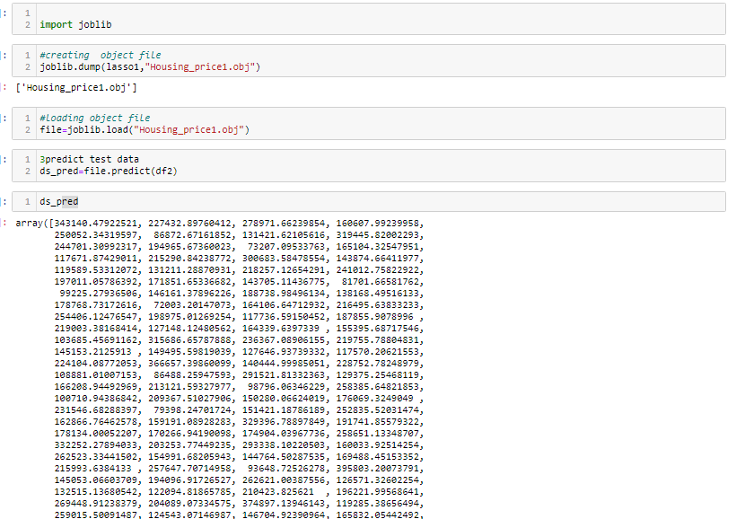
Creating final model with lasso regression

Slide 26
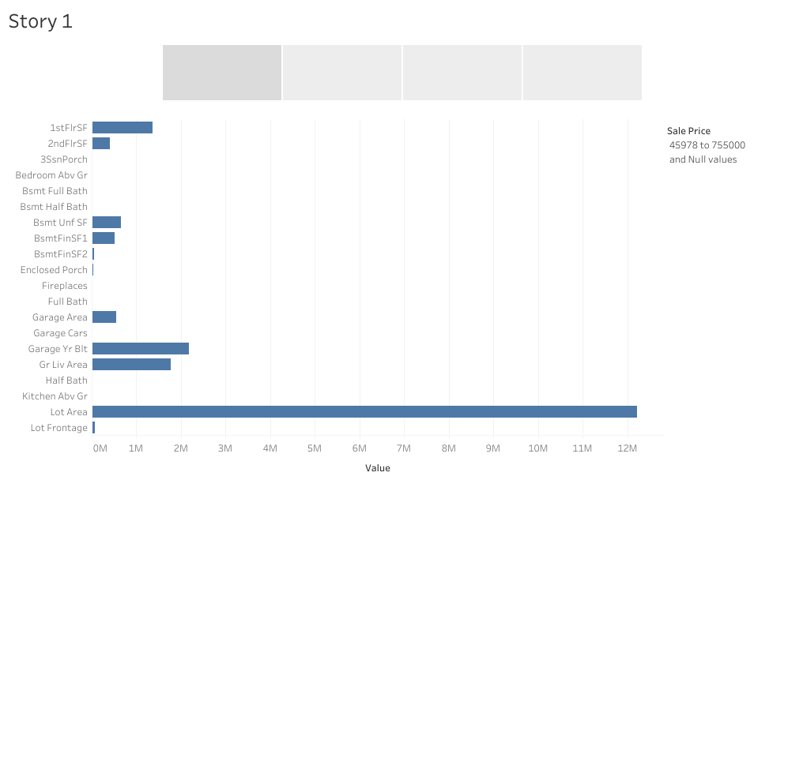
Followings are input features which show impact on sale price

Slide 27
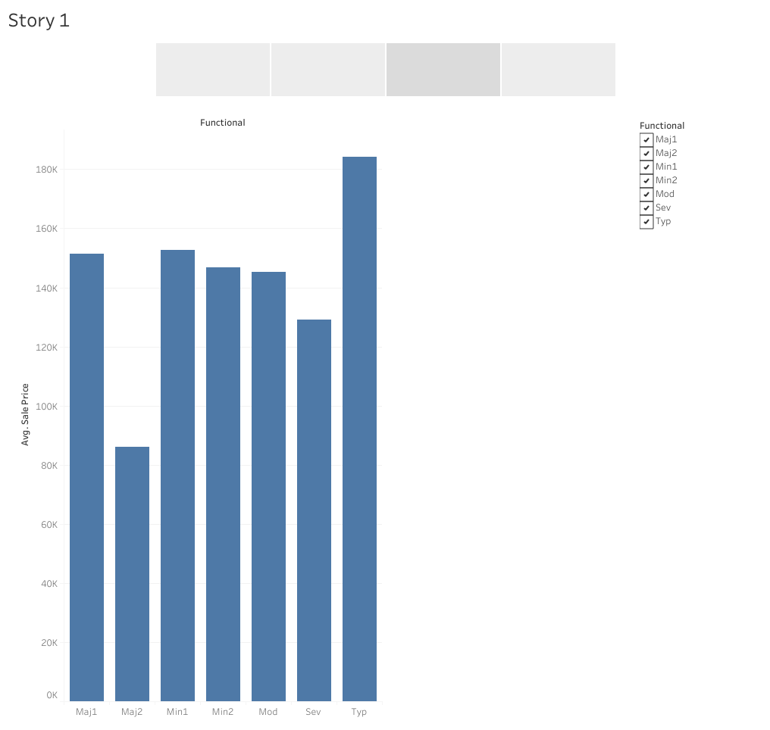

Slide 28
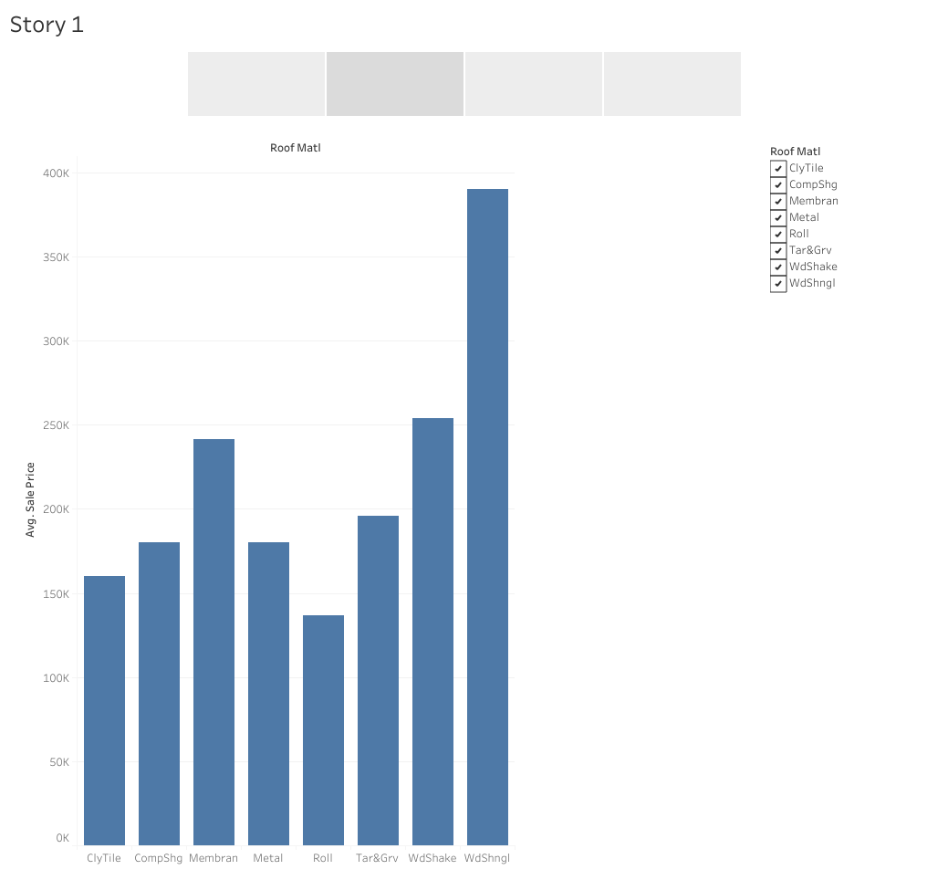

Slide 29
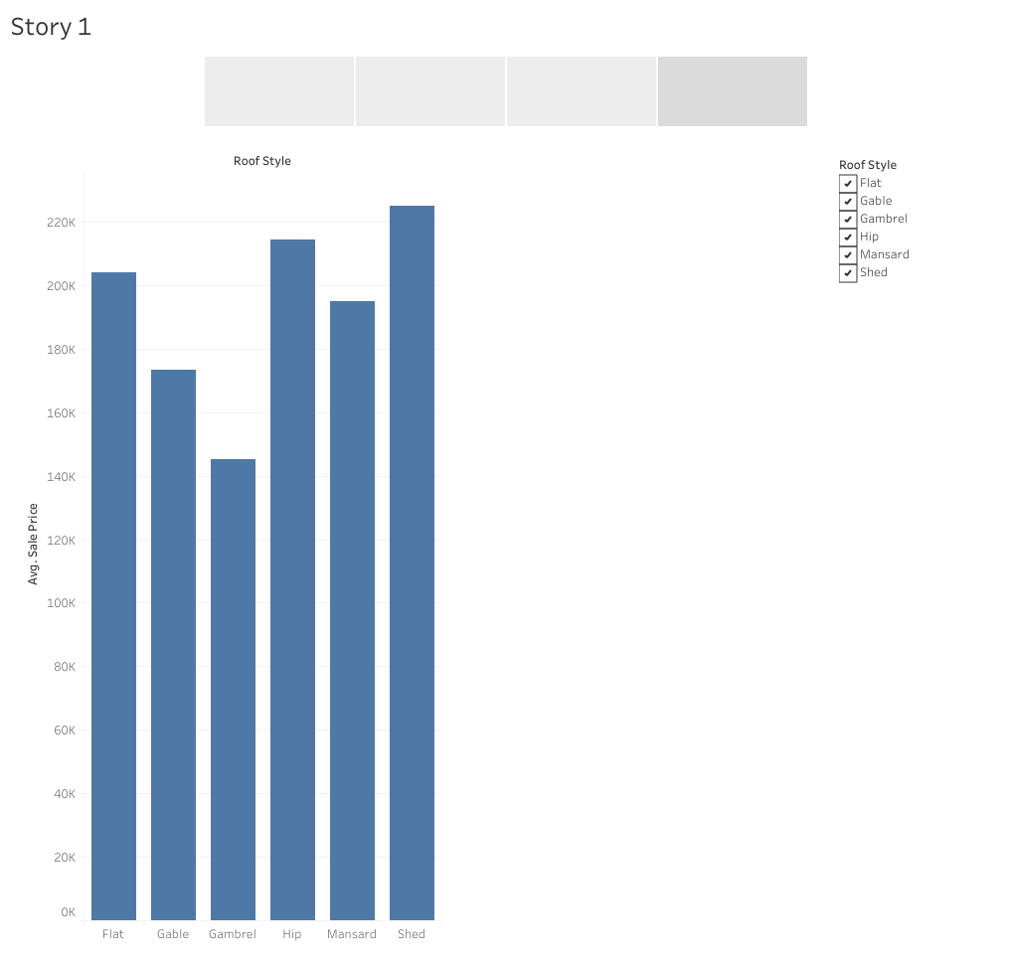

Slide 30
Conclusion
We have defined several models with various features and various model complexities. There is a need to use a mix of these models a linear model gives a high bias (under fit) whereas a high model complexity-based model gives a high variance (overfit). Data Scientist tends to overfit their models which can be reduced by ridge regression
and LASSO The study reveals that economic factors influence land price more than the social factors. The interaction of the selected factors (X) on sale price (Y) is analyzed.
Following some variables have most impact on output variables.
BsmtHalfBath : Basement half bathrooms
LowQualFinSF : Low quality finished square feet (all floors)
BsmtFullBath : Basement full bathrooms
HalfBath : Half baths above grade

